Slide 1
Capillaries

Slide 2
Capillaries
_Are very small vessels, their diameter ranges from (4-15)Mm, arising from the terminal end of the arterioles.
_The wall of a segment of capillarity may be formed by a single endothelial cell.
_Only tunica intimae is present ,which typically consist of the endothelium, its basal lamina and an in complete layer of cells surrounding the capillary, the pericytes.

Slide 3
These pericytes appear to have important roles in repair of blood vessels and connective tissue after injury, these cells have contractile properties and can regulate blood flow in capillaries.
They have the potential to develop in to fibroblasts, smooth muscle cells and may even be phagocytic.

Slide 4
Classification of Capillaries
1-Continouous capillaries (type I):
The endothelial cells forms a continuous internal lining without any intercellular or intra cytoplasmic defects, pericytes may be found in a associated with the endothelium of certain continuous capillaries.
Found in muscle,lung,CNS.

Slide 5
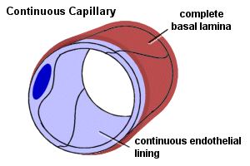

Slide 6
2-Fenestrated Capillaries (type II):
The endothelial cells are pierced by pores, which provide channels across the capillary wall.
Found in GIT mucosa, endocrine glands and in the renal (glomeruli).
3-Discontinuous capillaries (Sinusoid):
Are larger and more irregularly shaped than other capillaries, they are thin walled blood vessels lined by endothelial cells and specialized phagocytic cells, found in liver,spleen,bon marrow. usually wide gabs are present between the endothelial cells that permit leakage of material in to and out of these vessels.

Slide 7
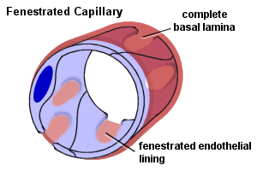

Slide 8
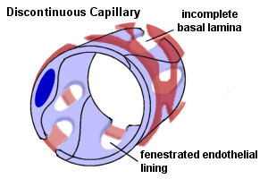

Slide 9
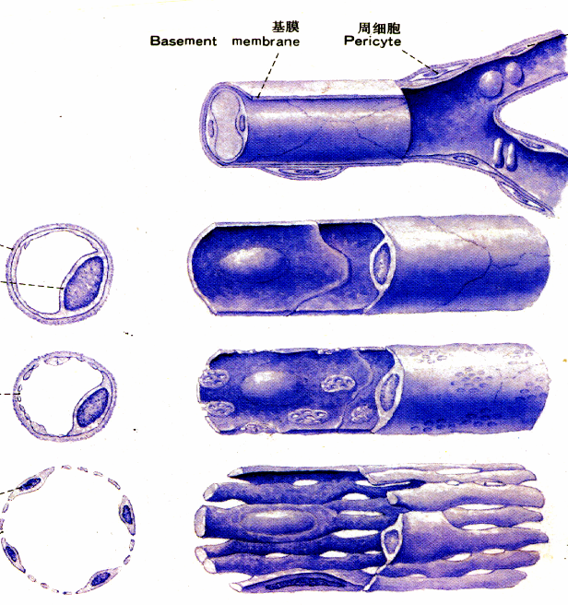
Classifications and ultrastrutural feature of Cap.
continuous cap.
fenestrated cap.
sinusoid

